Slide 1
Alkali Soluble Rheology Modifier
www.reachinchem.com

Slide 2
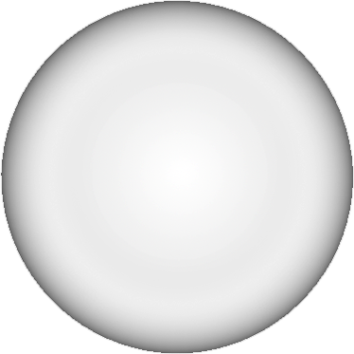

A special rheology modifier for transparent or suspension formulas-Repoly 100
Liquid, easy to use, with stabilizing, thickening and co-emulsifying functions
Has excellent transparency in transparent formula and enhances pearlescent effect in pearlescent products
Has excellent salt resistance and good compatibility with anionic and nonionic surfactants
Benefits
Effective suspension of insoluble, difficult to suspend components or particles, such as anti-dandruff agent, silicone oil, petal, bead, etc

Slide 3
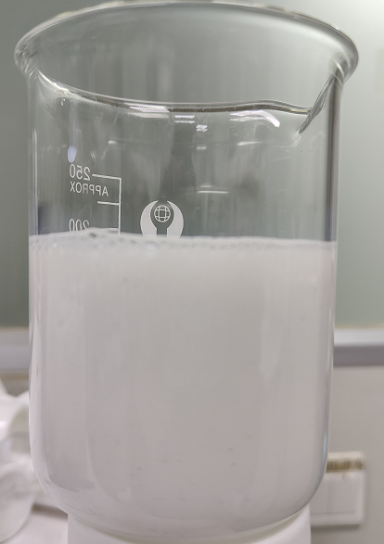
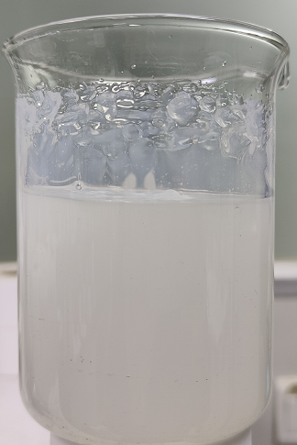
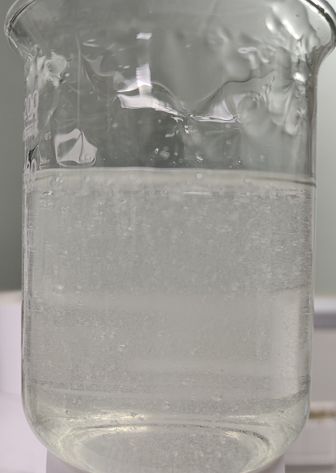
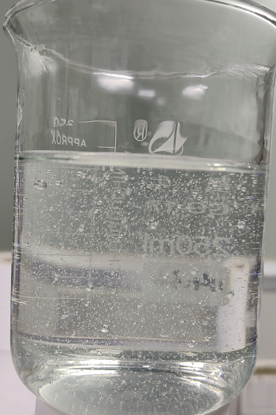
Formulation process appearance
+ 32%NaoH
+ 32%NaoH
Step 1
Water
Repoly 100：7%
pH = 3.0
Step 2
Water
Repoly 100：7%
SLES：18%
CDEA ：2%
pH = 5.5
pH = 6.5
pH = 6.9

Slide 4
A special rheology modifier for transparent or suspension formulas-Repoly 100
Specification
Item | Specification
Appearance(25℃) | Milky white liquid
Solid content(%) | 34.0-36.0
pH | 2.1-3.8
1%solids aqueous solution(mPa·s) | 4000-8000
Residual ethyl acrylate(mg/kg) | 0-1.0

Slide 5
Thickening mechanism
H₂O
H₂O
H₂O
OH⁻
H₂O
H₂O
Alkali
Swellable
Emulsion Thickeners
H₂O
H₂O
H₂O
Unactivated Polymer
Activated polymer

Slide 6
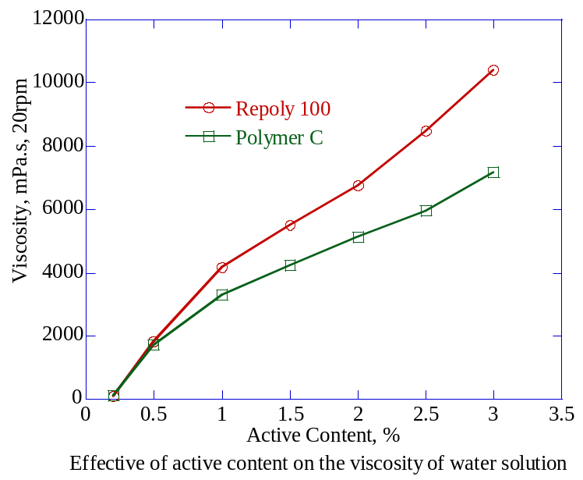
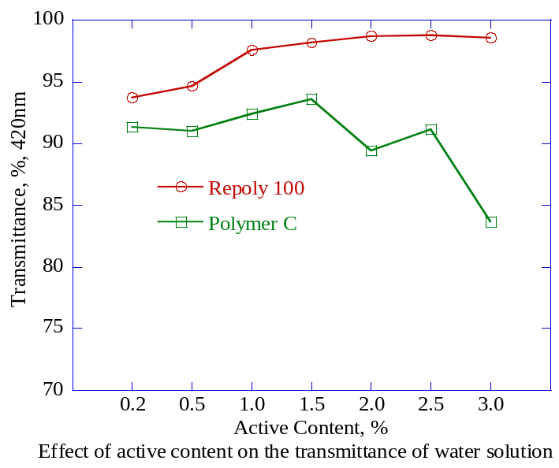
Performance comparison
(We compare with polymer C from competitor)
Effect of active content on the viscosity and transmittance of water solution
The viscosity of neutralized water solution increases with the increasing of active content, Repoly 100 is better than Polymer C on viscosity. For the transmittance, Repoly 100 shows an increasing trend with the increasing of active content, while polymer C shows a decreasing trend after a small increasement, the transmittance of Repoly 100 is better than Polymer C.

Slide 7
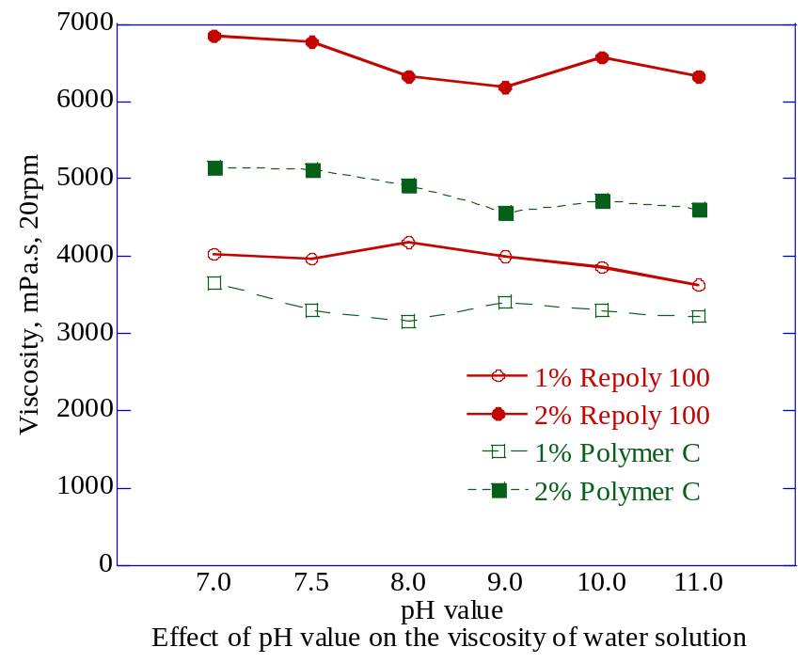
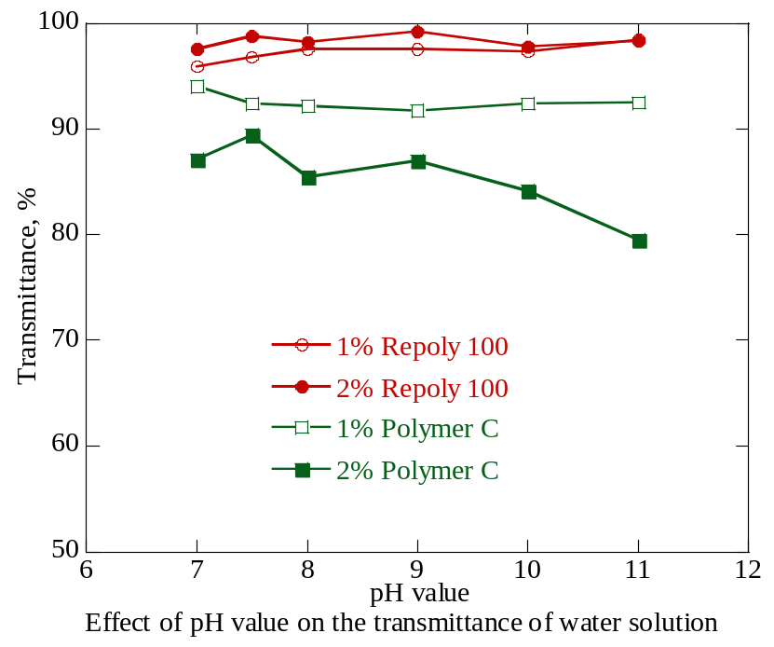
Performance comparison
(We compare with polymer C from competitor)
Effect of pH value on the viscosity and transmittance of water solution
The viscosity of neutralized water solution is stable within the range of pH=7.0 to pH=11.0, and Repoly 100 exhibits a better thickening efficiency compared with Polymer C. The transmittance isn’t affected by the pH value within the given range, except for the transmittance of 2% Polymer C’s solution decreases with the increasing of pH value.

Slide 8
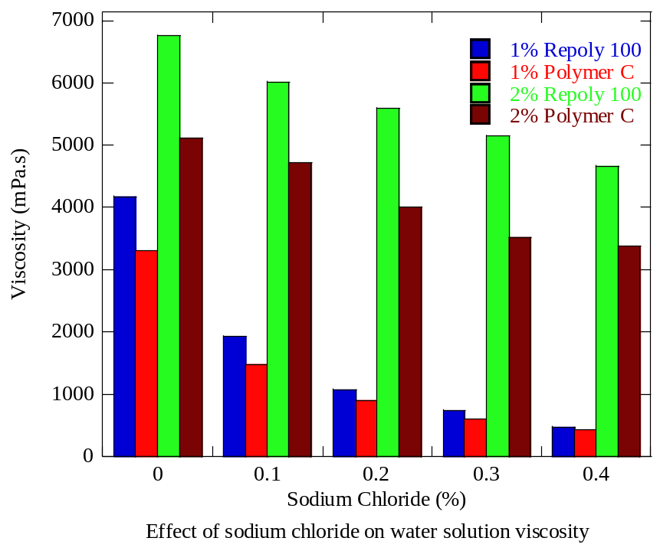
Performance comparison
(We compare with polymer C from competitor)
Electrolyte resistance of Repoly 100
The electrolyte resistance of Repoly 100 is very good, especially for the large polymer amount solution.

Slide 9
Performance comparison
Effect of pH value on performance of a typical formula
INCI Name | Weight % | Function
Deionized Water | To 100 | Diluent
SLES, 2EO, 70% | 16 | Surfactant
Acrylates Copolymer, base on solid | 2.1 | Rheology Modifier
Sodium Hydroxide, 18% | Base on the pH control | Neutralizer
Cocamidopropyl Betaine, 35% | 14.3 | Surfactant
Kathon, 2.5% | 0.06 | Preservative

Slide 10
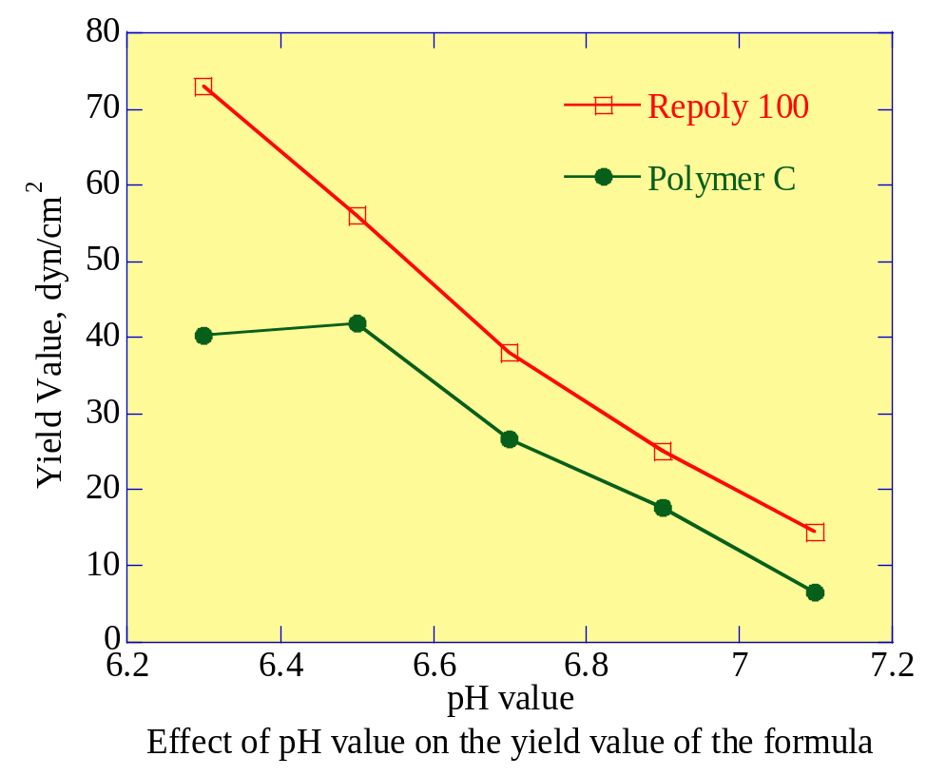
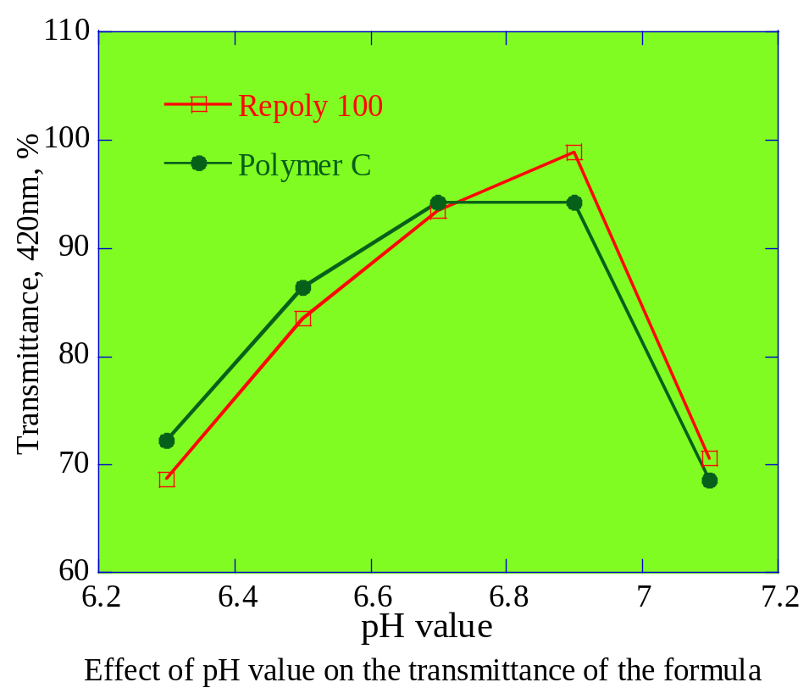
Performance comparison
(We compare with polymer C from competitor)
Effect of pH value on performance of a typical formula
The yield value of Repoly 100 is larger than polymer C in this test formula, especially with the low pH value.

Slide 11
Performance comparison
Effect of electrolyte on performance of a typical formula
INCI Name | Weight % | Function
Deionized Water | To 100 | Diluent
SLES, 2EO, 70% | 16 | Surfactant
Acrylates Copolymer, base on solid | 2.1 | Rheology Modifier
Sodium Hydroxide, 18% | Adjust pH=6.8 | Neutralizer
Cocamidopropyl Betaine, 35% | 14.3 | Surfactant
Sodium Chloride | 0, 0.2, 0.4, 0.6, 0.8 | Electrolyte
Kathon, 2.5% | 0.06 | Preservative

Slide 12
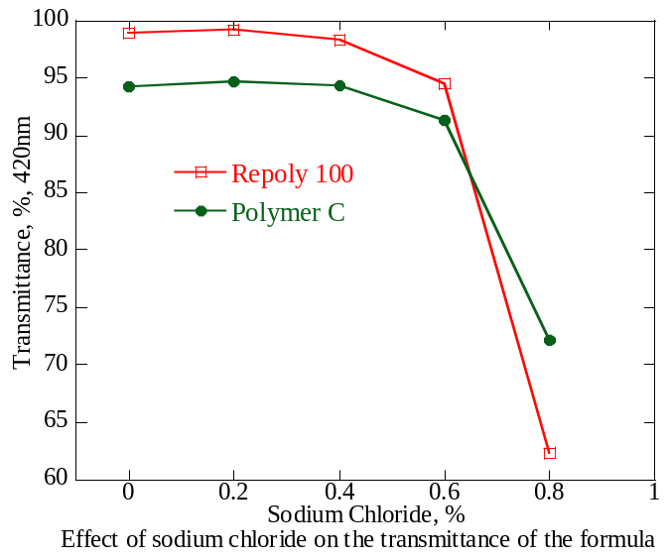
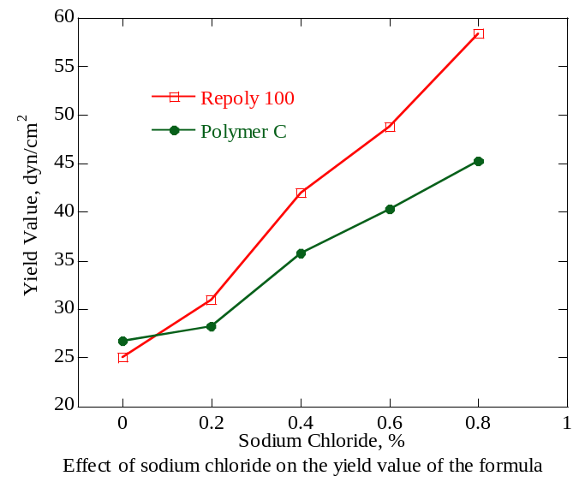
Performance comparison
(We compare with polymer C from competitor)
Effect of electrolyte on performance of typical formula
The yield value of Repoly 100 is larger than polymer C in this test formula. When the electrolyte content is more than 0.4%, the transparency shows a decreasing trend, and the performance is basically the same.

Slide 13
Performance comparison
Effect of CAB on the performance of a typical formula
INCI Name | Weight % | Function
Deionized Water | To 100 | Diluent
SLES, 2EO, 70% | 16 | Surfactant
Acrylates Copolymer, base on solid | 2.1 | Rheology Modifier
Sodium Hydroxide, 18% | Adjust pH=6.8 | Neutralizer
Cocamidopropyl Betaine, 35% | 20, 14.3, 8.57, 2.86 | Surfactant
Kathon, 2.5% | 0.06 | Preservative

Slide 14
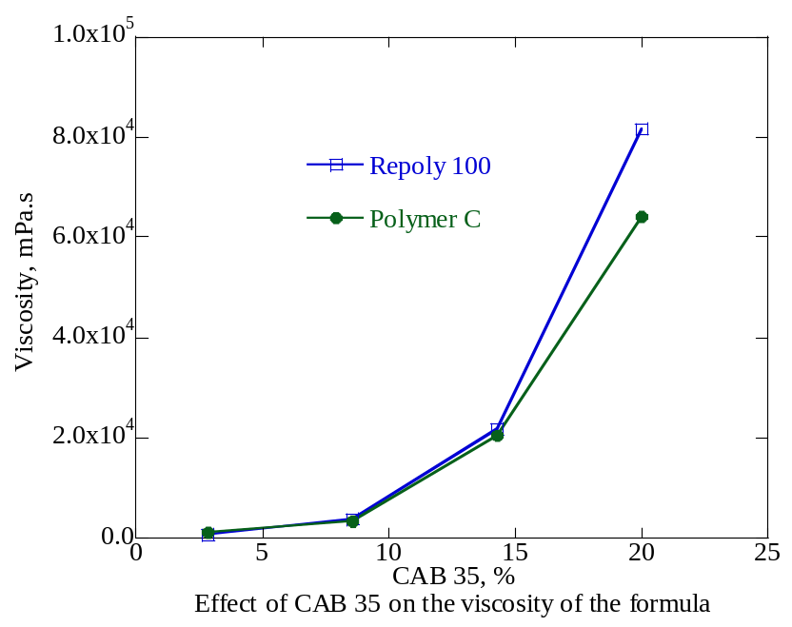
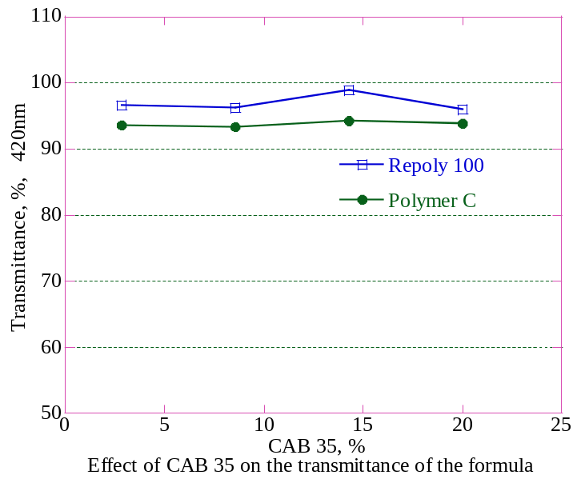
Performance comparison
(We compare with polymer C from competitor)
Effect of CAB on the performance of a typical formula
With the increase of CAB content, the viscosity of tested formula showed an upward trend. When the content of CAB was more than 15%, the viscosity of Repoly 100 is larger than polymer C. The addition of CAB had no significant effect on the transparency of the formula.

Slide 15
Performance comparison
Effect of SLES-2EO on performance of a typical formula
INCI Name | Weight % | Function
Deionized Water | To 100 | Diluent
SLES, 2EO, 70% | 8, 12, 16, 20 | Surfactant
Acrylates Copolymer, base on solid | 2.1 | Rheology Modifier
Sodium Hydroxide, 18% | Adjust pH=6.8 | Neutralizer
Cocamidopropyl Betaine, 35% | 14.3 | Surfactant
Kathon, 2.5% | 0.06 | Preservative

Slide 16
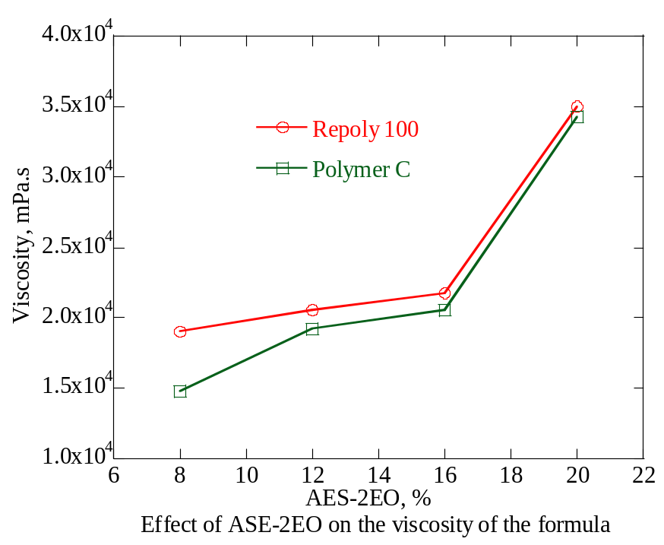
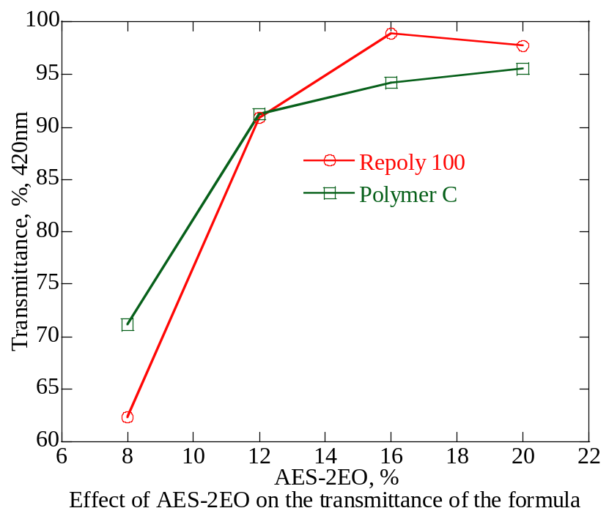
Performance comparison
(We compare with polymer C from competitor)
Effect of SLES-2EO on performance of a typical formula
With the increase of SLES-2EO content, the viscosity of tested formula showed an upward trend, and the viscosity of Repoly 100 is larger than polymer C. When the content of SLES-2EO is more than 12%, Repoly 100 shows better transparency.

Slide 17
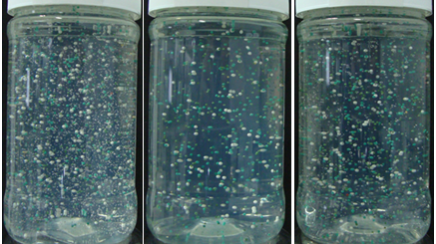
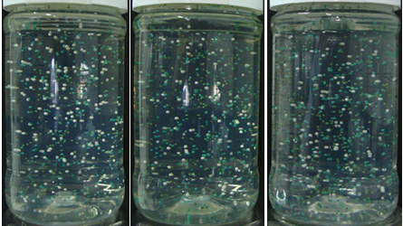
Suspending performance
(We compare with polymer C from competitor)
Repoly 100 7% Repoly100 7% Polymer C
Viscosity 20000cps Viscosity 30000cps Viscosity 30000cps
Test formula
Ingredients | % w/w
Aqua | TO100
SLES (70%) | 16
Repoly100 | 7
NaOH | q.s
DOE120 | q.s adjust viscosity
CAB 35 | q.s adjust viscosity
Preservative | 0.06
Formula finished
status
Keep at 48℃
for 1 week

Slide 18
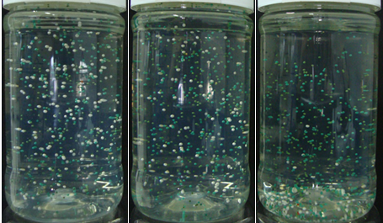
Suspending performance
(We compare with polymer C from competitor)
Repoly 100 7% Repoly100 7% Polymer C
Viscosity 20000cps Viscosity 30000cps Viscosity 30000cps
Test formula
Ingredients | % w/w
Aqua | TO100
SLES (70%) | 16
Repoly100 | 7
NaOH | q.s
DOE120 | q.s adjust viscosity
CAB 35 | q.s adjust viscosity
Preservative | 0.06
Keep at 48℃ for 4 weeks
✎ test result: suspending effect related to dosage of Repoly 100, but not to viscosity of formula.

Slide 19
Synergy with Sodium Chloride
Formula | %
Water | To100
Repoly 100 | 5.0
SLES (30%) | 39
32%NaOH | to pH 6.7-7.0
CAPB (30%) | 8.0
NaCl | 0，0.5，1，1.5
Sodium Chloride has the feature to thicken efficiently surfactants based formulation at concentration tipically ; the synergy between Sodium Chloride and Repoly 100 permits to reach high viscosity

Slide 20
Effect on the foam
In the figure below we show the effect of different % of Repoly 100 on the foaming action of a basic bubble bath formula compared to a classical surfactant systemviscosifier.
Ross Miles Foam test in water
Formula | %
Water | To100
Repoly 100 | 0，5，7，9
SLES (30%) | 39
32%NaOH | to pH 7.0
CAPB (30%) | 8.0
The addition of Repoly 100 has not a significant effect on the foam behaviour of the finished formulation.

Slide 21
Acrylates Copolymer has been used as many as 70070 times in all commodities. The data comes from Meilixiuxing app.
Foundation
Shampoo
Shower gel
Application
Sunscreen
Facial Cleanser
Formula with ethanol, isopropanol, propylene glycol and glycerol

Slide 22
Formula Guidelines
The recommended dosage is 5-8% in the surfactant system and more than 7% of the suspended particles
Repoly 100
The recommended dosage is 3-5% in emulsion system
In order to achieve the best effect, the total amount of surfactant is recommended to be added to 15-23%
In order to achieve the best transparency, it is suggested to adjust the pH to 6.5-7.0

Slide 23
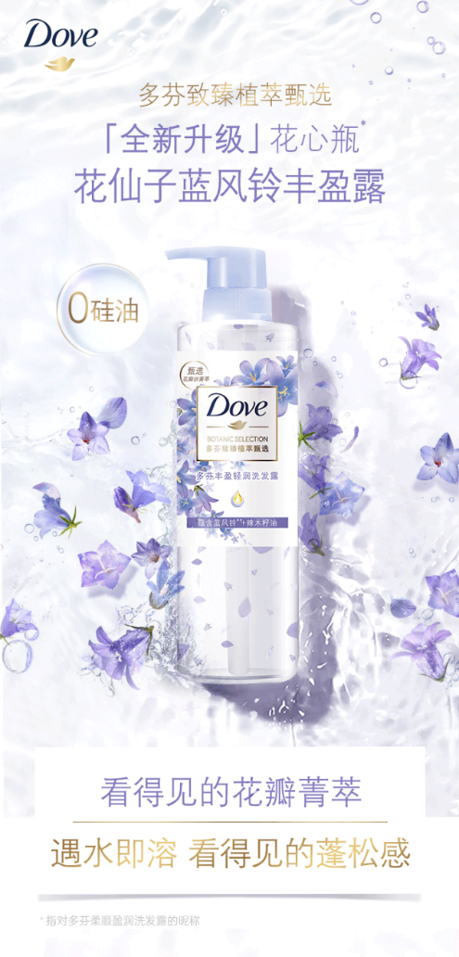
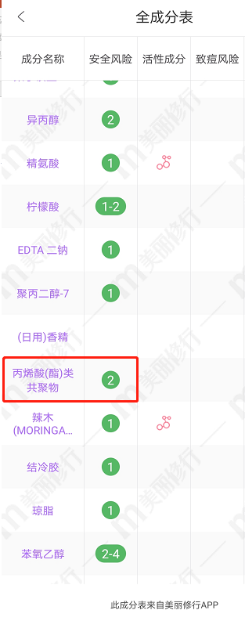
Product on marketing
Acrylates Copolymer, as a suspension stabilizer, can effectively suspend petals
DOVE Botanic Selection Shampoo

Slide 24
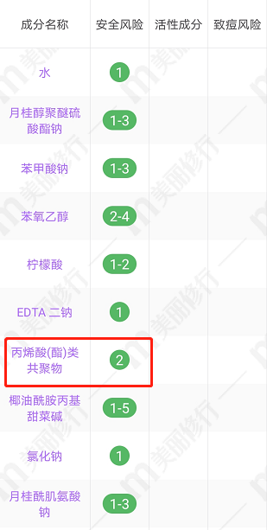
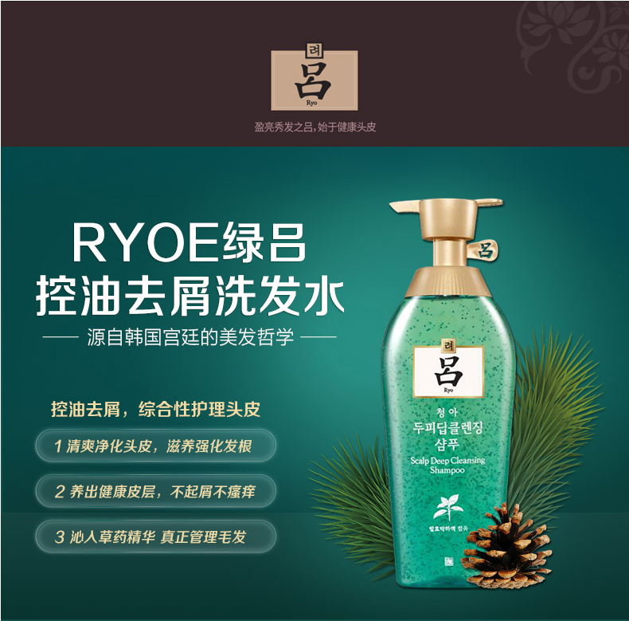
Product on marketing
Acrylates Copolymer, as a suspension stabilizer, can effectively suspend beads and anti-dandruff agent
Ryo Deep Cleansing Scalp Care Shampoo

Slide 25
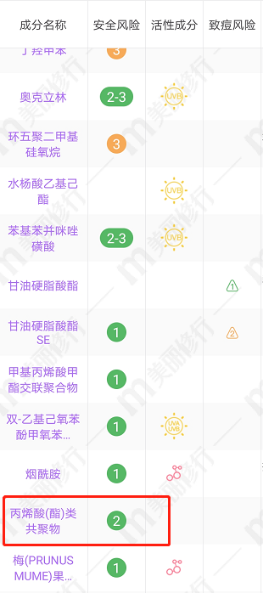
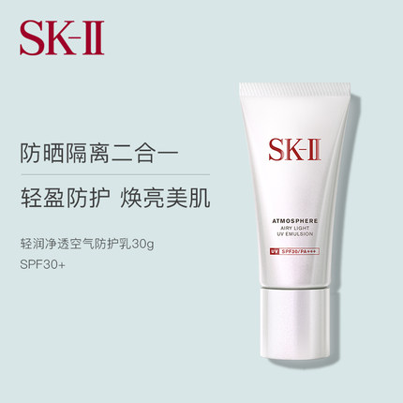
Product on marketing
Acrylates Copolymer can stabilize the system and form water resistance film on skin
SK-II Atmosphere Airy Light UV Cream

Slide 26
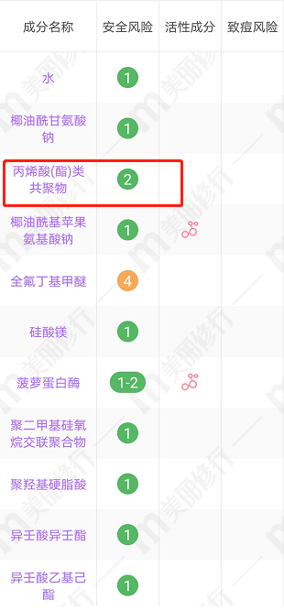
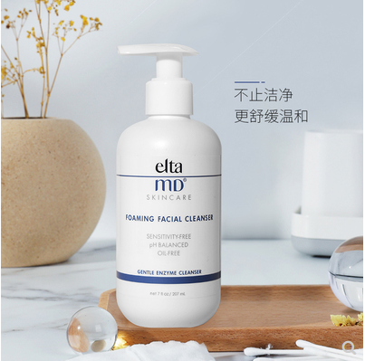
Product on marketing
Acrylates Copolymer can stabilize the system and make foam easy to rinse, no residue
Elta MD foaming facial cleanser

Slide 27
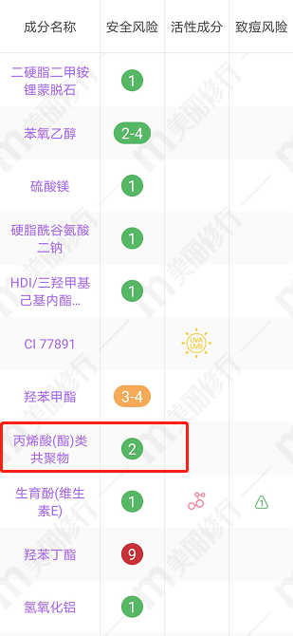
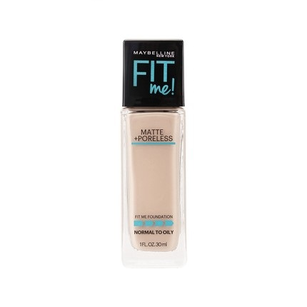
Product on marketing
Maybelline FIT me foundation
Acrylates Copolymer can stabilize the system and form water resistance film on skin

Slide 28
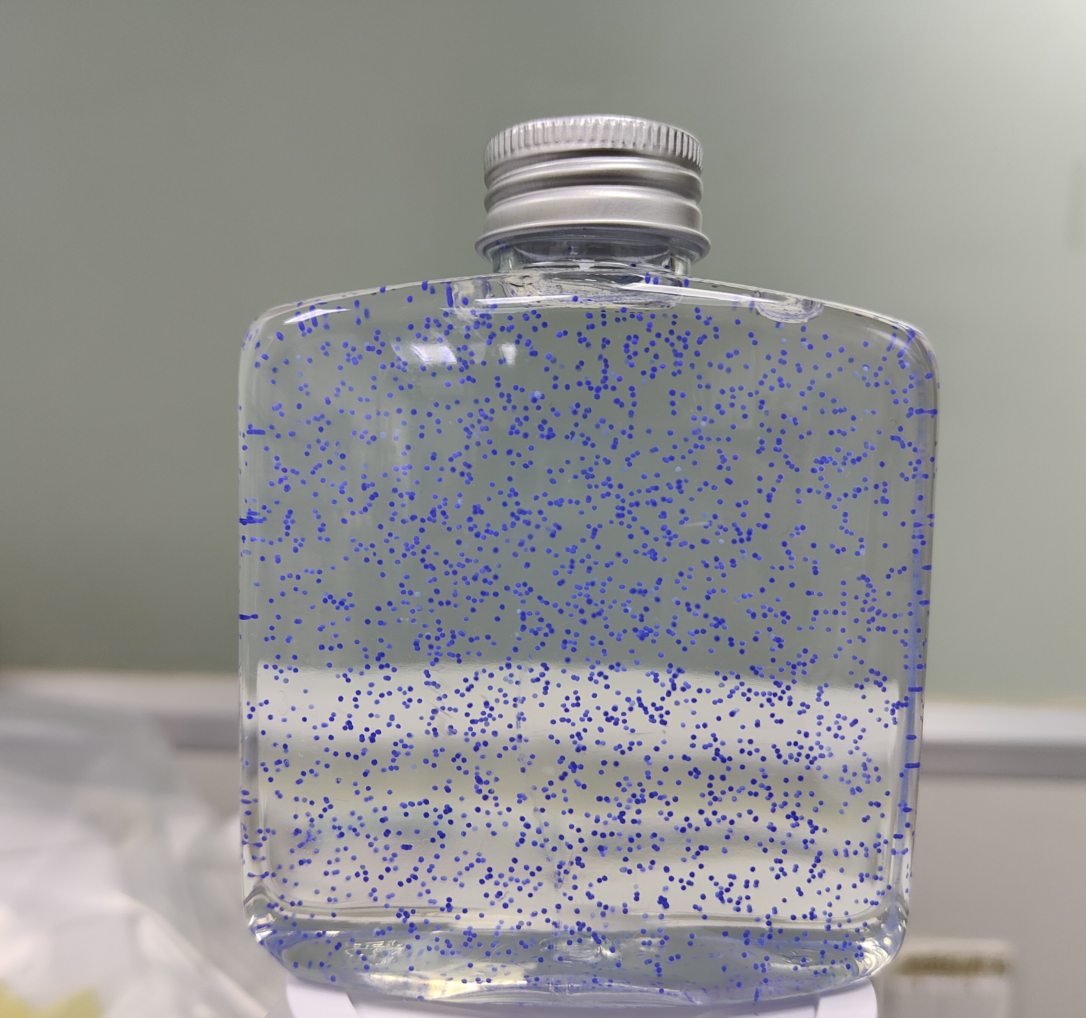
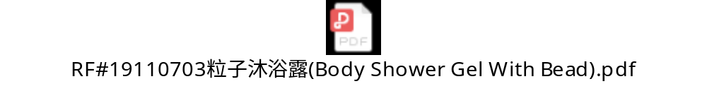
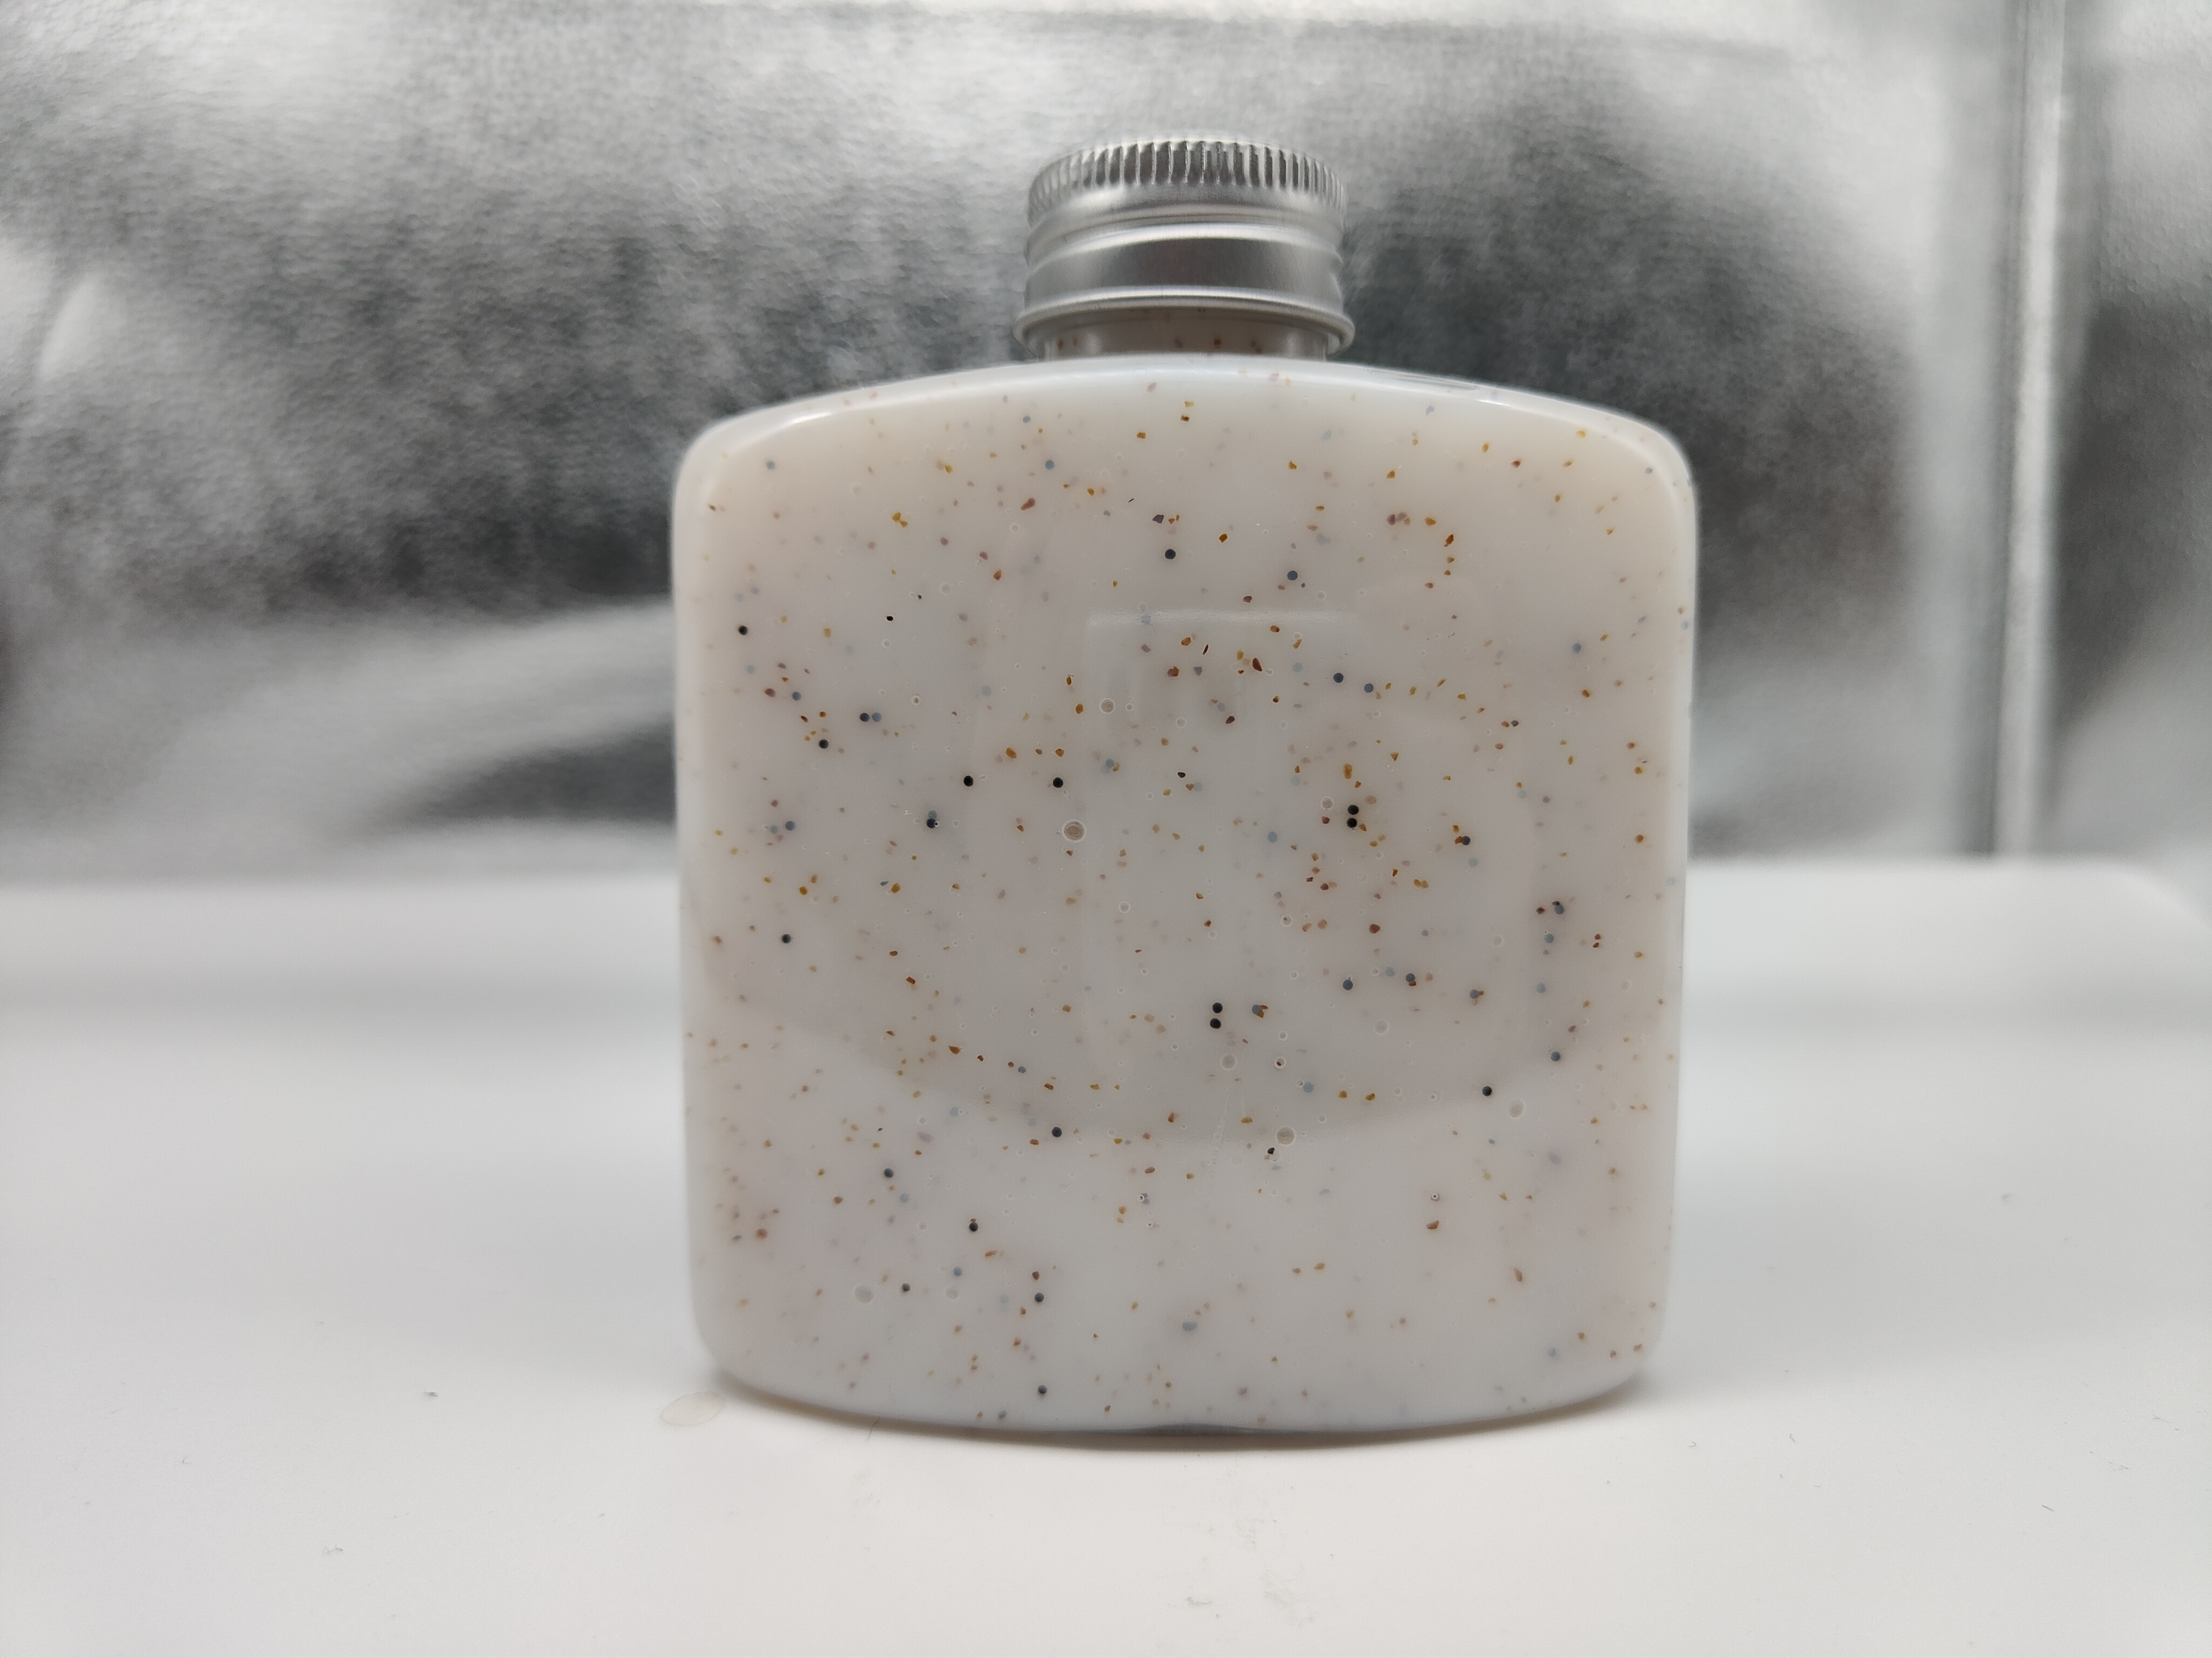
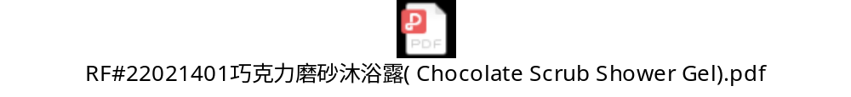
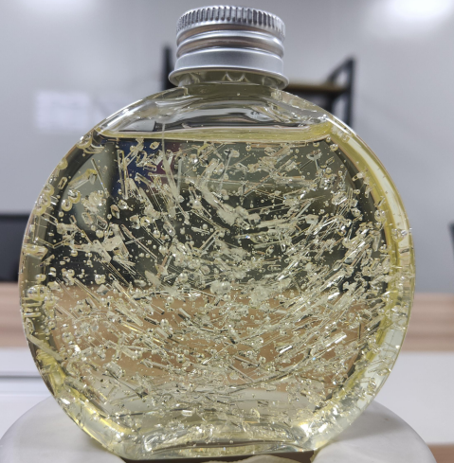
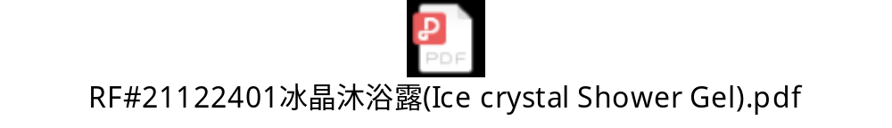
Reference formula
Clear bath gel with beads
Chocolate Scrub Shower Gel
Clear bath gel with ice crystal

Slide 29
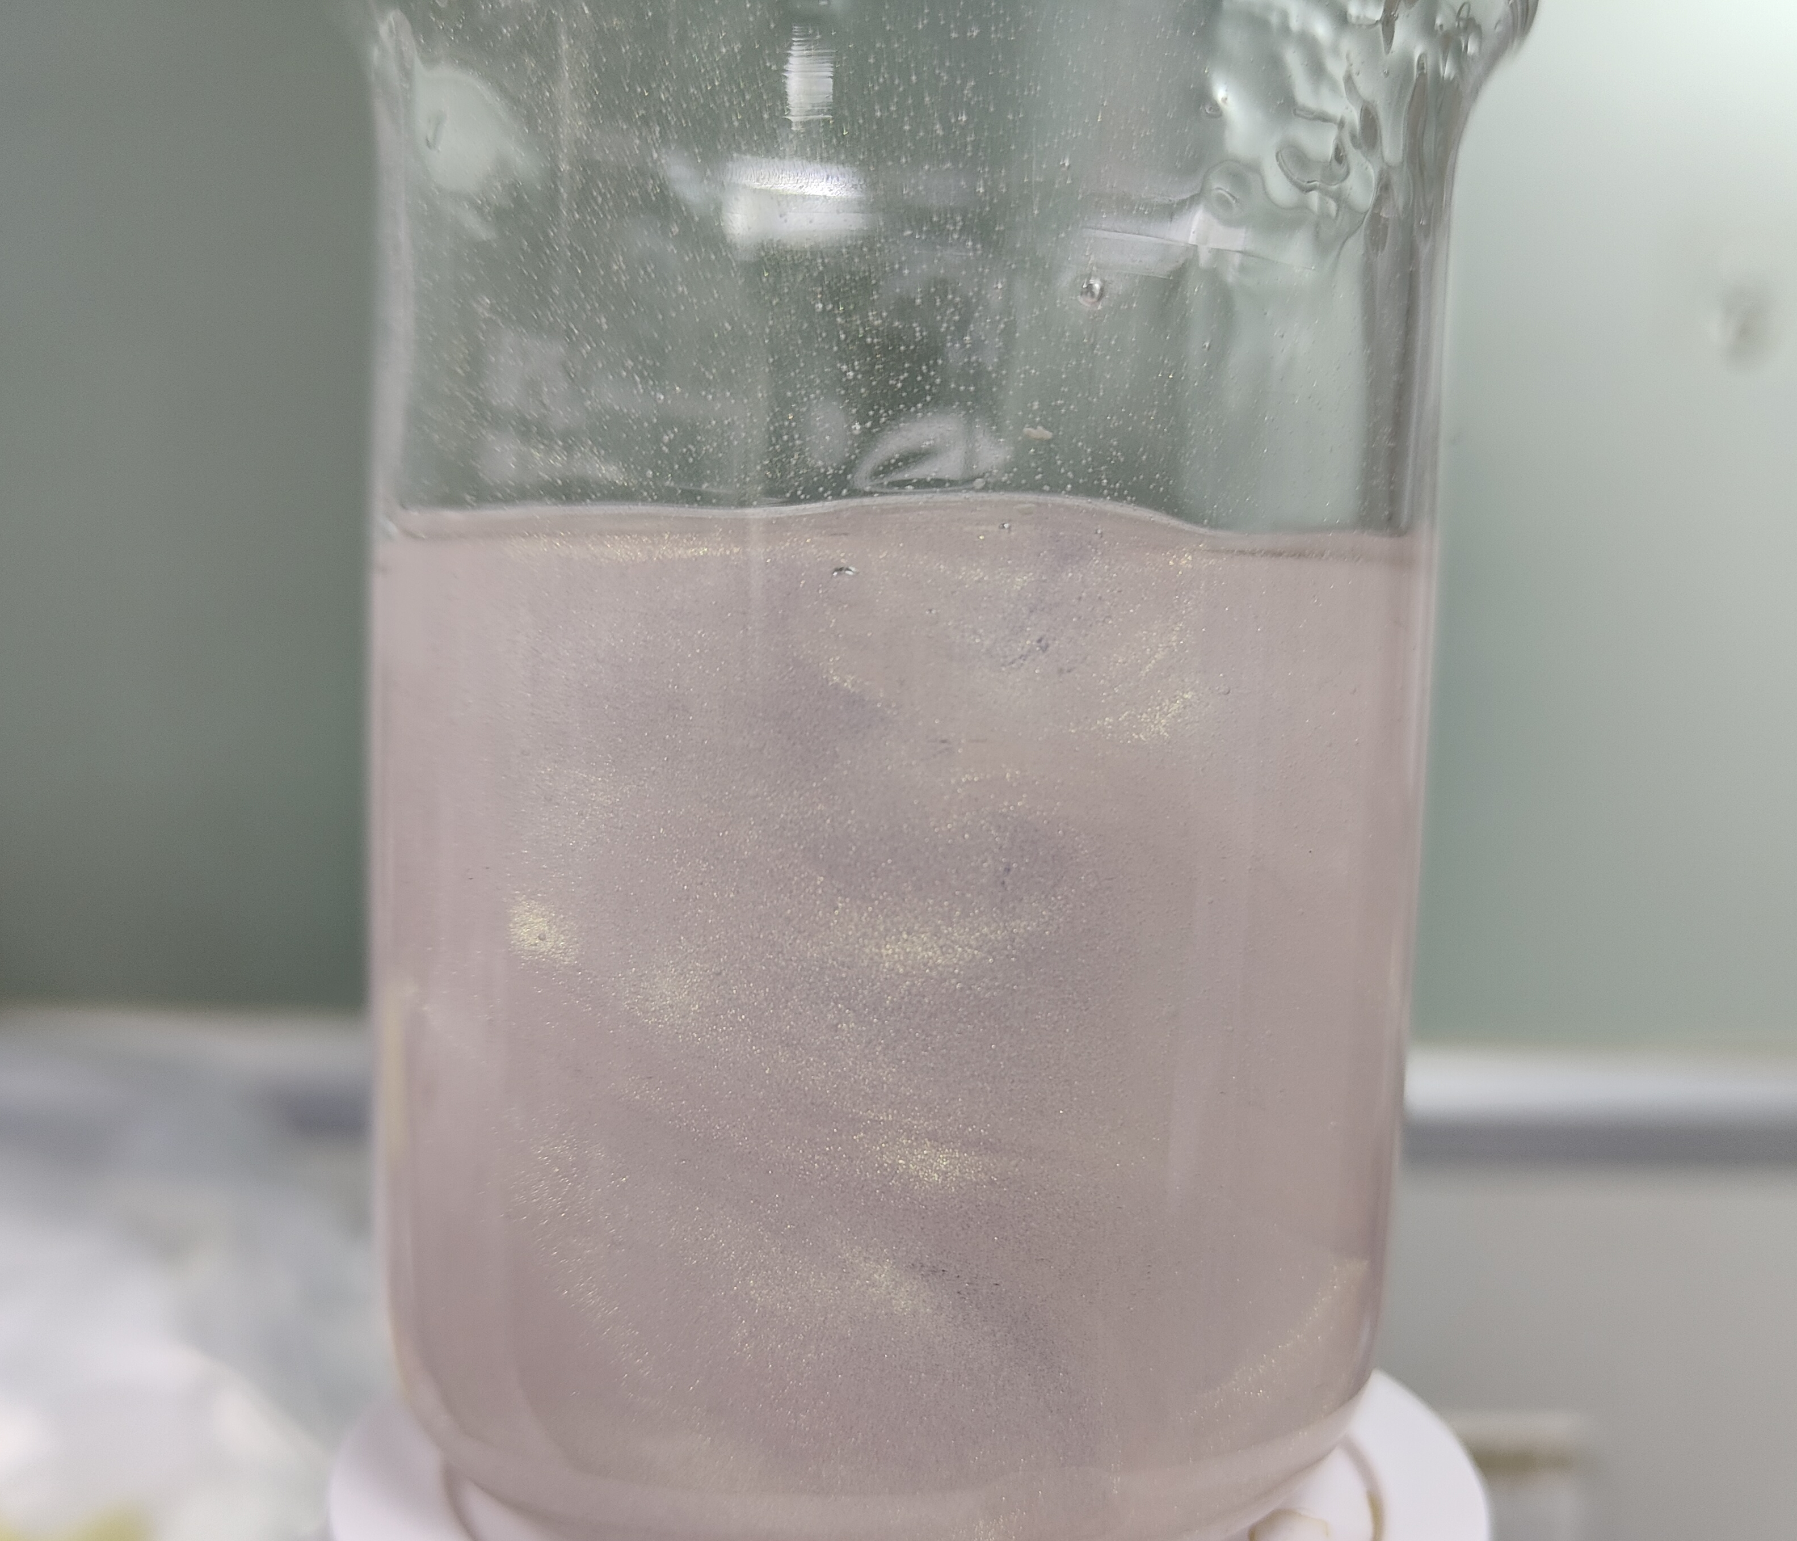
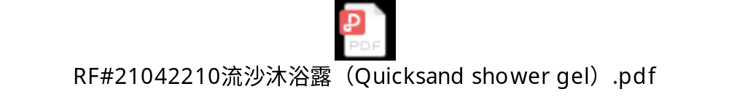
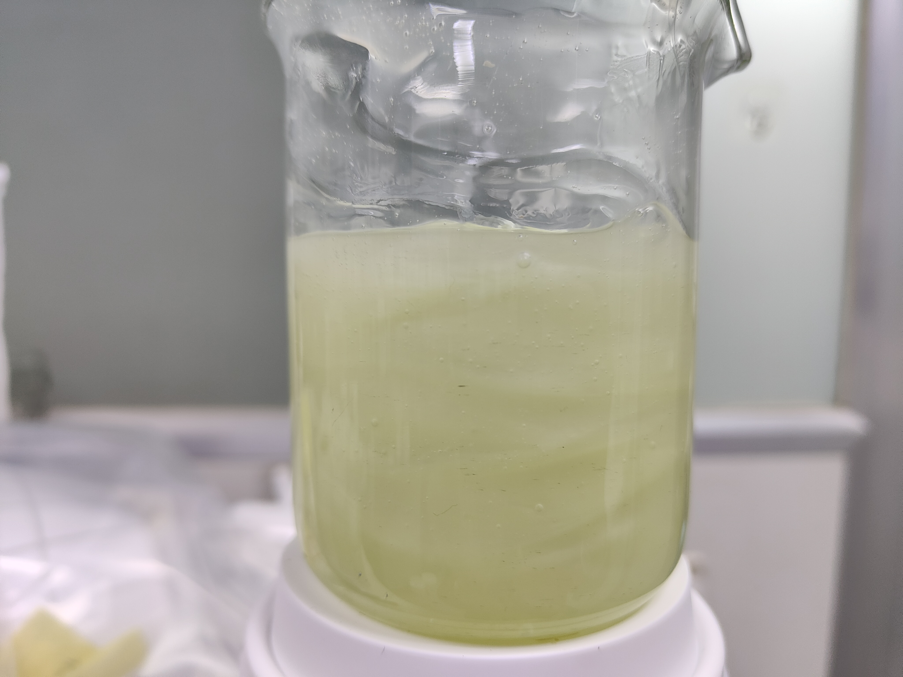
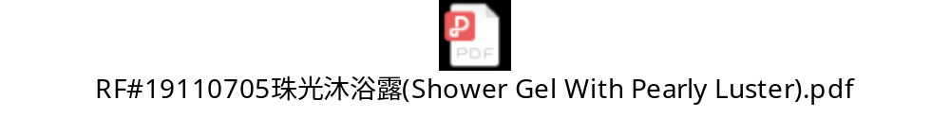
Reference formula
Quicksand shower gel
Pearly bath gel

Slide 30
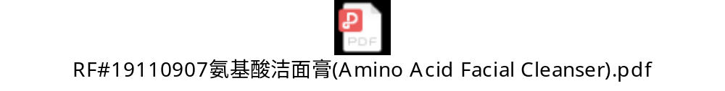
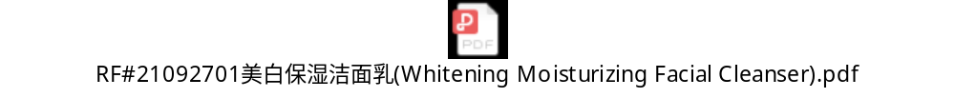
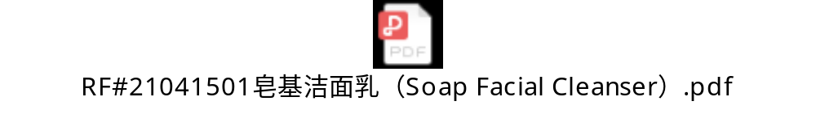

Reference formula
Effectively thicken and stabilize formulation system
Effectively stabilize formulation system, and solve the problem of soap base instability and easy coarsening
Effectively suspend silicone oil emulsion and opacifier, stabilize formulation system

Slide 31
If you are interested in these products, please contact us!
Thank you!
【Telephone】
020-37087379
【E-mail】
helena@reachinchem.com

